Slide 1
Lecture 6a
Convolutional network
Vgg: A classification network

Slide 2
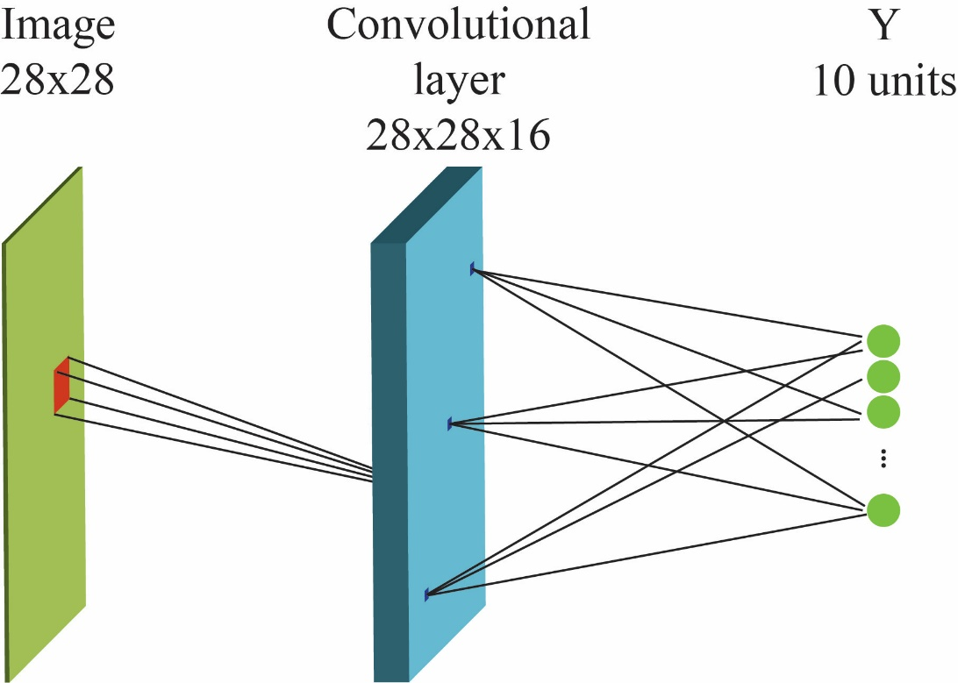
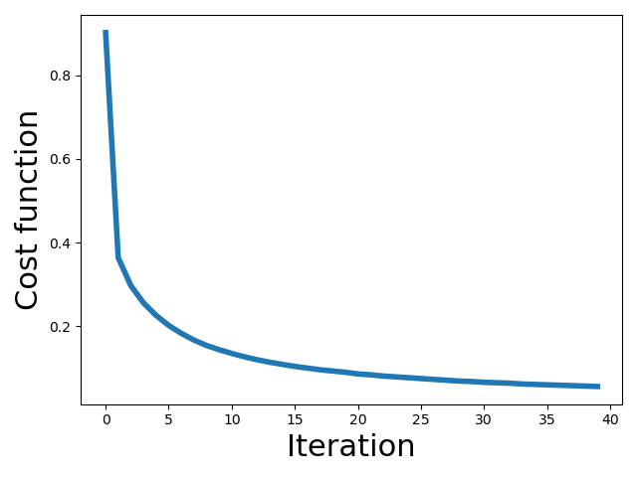
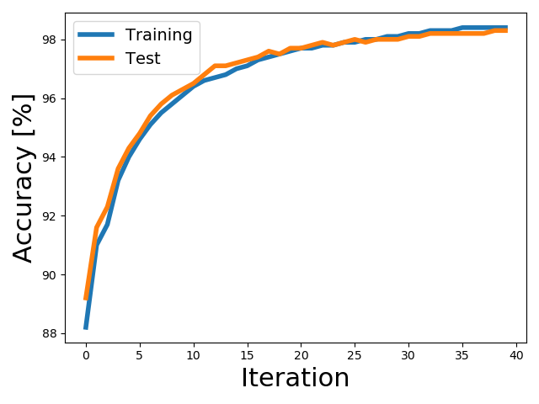
Two-layer convolutional network (digits MNIST)
60000 Training samples
10000 Test samples
Optimizer: gradient descent, MSE
Rectified linear activation function in the middle layer
Softmax activation function in the final layer
Receptive field : 20x20
Batch size : 1000
Epochs: 40
Learning rate:0.05
Convolutional 1st layer
Training accuracy: 98.4%
Test accuracy: 98.3% 125K weights
Fully connected 1st layer (20 HU)
Training accuracy: 97%
Test accuracy: 95.7% 16K weights
Fully connected network parameters: 100 epoch, 1 learning rate, sigmoid activation in the middle layer, 1000 batch size
The receptive fields of the convolutional layer are trained simultaneously for all positions

Slide 3
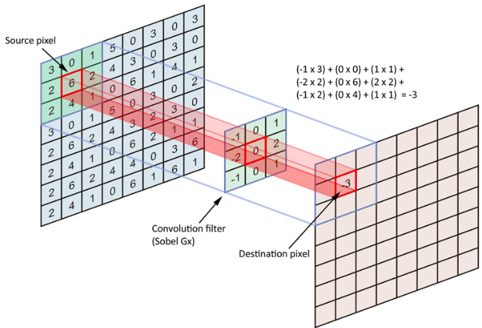
Feature detection using discrete 2-dimensional convolution with a filter Template matching
Image
Feature layer
Convolution of the image with a learnt filter (template) identifies the structure in the image and localises it in the feature layer

Slide 4
Convolution: Single channel input – single filter
Input
Feature layer: 1/1
0 | 0 | 0 | 0 | 0 | 0 | 0 | 0
0 | 0 | 0 | 0 | 0 | 0 | 0 | 0
0 | 0 | 1 | 1 | 1 | 1 | 0 | 0
0 | 0 | 1 | 0 | 0 | 1 | 0 | 0
0 | 0 | 1 | 0 | 0 | 1 | 0 | 0
0 | 0 | 1 | 1 | 1 | 1 | 0 | 0
0 | 0 | 0 | 0 | 0 | 0 | 0 | 0
0 | 0 | 0 | 0 | 0 | 0 | 0 | 0
0 | 0 | 0 | 0 | 0 | 0 | 0 | 0
0 | 0 | 1 | 1 | 1 | 1 | 0 | 0
0 | 0 | 2 | 1 | 1 | 2 | 0 | 0
0 | 0 | 3 | 1 | 1 | 3 | 0 | 0
0 | 0 | 3 | 1 | 1 | 3 | 0 | 0
0 | 0 | 2 | 1 | 1 | 2 | 0 | 0
0 | 0 | 1 | 1 | 1 | 1 | 0 | 0
0 | 0 | 0 | 0 | 0 | 0 | 0 | 0
0 | 1 | 0
0 | 1 | 0
0 | 1 | 0
X
Filter kernel # Filters = n_{f} = 1
Size: [f_{x} , f_{y}] = [3, 3]
Filter depth = n_{c} = 1
Filter bias = b = 0
# Filter weights: = f_{x} x f_{y} x n_{c} + 1 = 3x3x1 + 1 = 10
Stride: [s_{x} , s_{y}] = [1, 1]
Input – image or feature layer from previous convolution block Size: [L_{x} , L_{y}] = [8, 8]
# Channels: [n_{c}] = 1
Zero padded
Output – feature layer
# Feature layers = n_{f} = 1
Size: [F_{x} , F_{y}] = [8, 8]
# Channels / feature = 1
Detects vertical edges

Slide 5
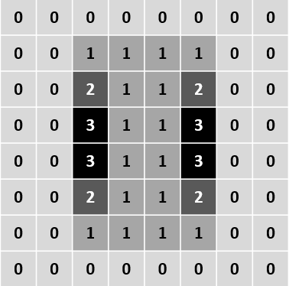
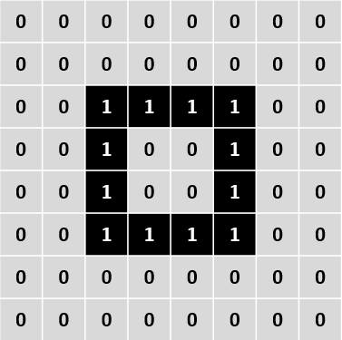
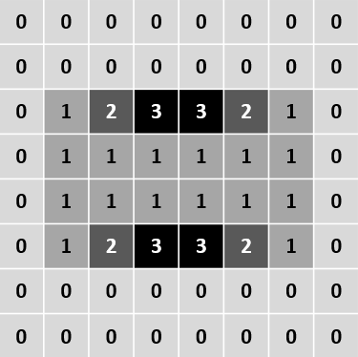
Convolution: Single channel input – Multiple filters Multiple feature detection
Feature layer: 1/2
Filter: 1
0 | 1 | 0
0 | 1 | 0
0 | 1 | 0
Input
X
Feature layer: 2/2
Filter: 2
0 | 0 | 0
1 | 1 | 1
0 | 0 | 0
X
Input – image or feature layer from previous convolution block Size: [L_{x} , L_{y}] = [8, 8]
# Channels: [n_{c}] = 1
Zero padded
Filter kernels # Filters = n_{f} = 2
Size: [f_{x} , f_{y}] = [3, 3]
Filter depth = n_{c} = 1
Filter bias = b = 0
# Filter weights = 10
Stride: [s_{x} , s_{y}] = [1, 1]
Detects vertical and horizontal edges
Output – feature layers
# Feature layers = n_{f} = 2
Size: [F_{x} , F_{y}] = [8, 8]
# Channels / feature = 1

Slide 6
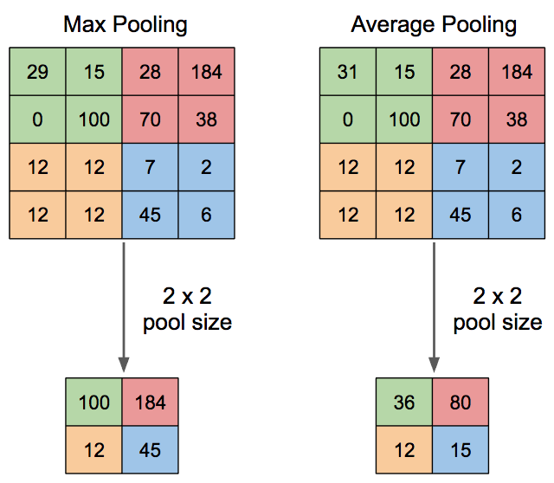
Spatial down-sampling using pooling functions
More common Higher response

Slide 7
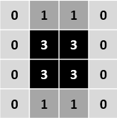
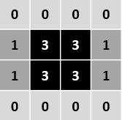
Max pooling of feature layers
Feature layer: 1/2
Max pooling
Filter: 1
0 | 1 | 0
0 | 1 | 0
0 | 1 | 0
Image or feature layer from previous convolution block
X
Feature layer: 2/2
Filter: 2
0 | 0 | 0
1 | 1 | 1
0 | 0 | 0
X
Input Size: [L_{x} , L_{y}] = [8, 8]
# Channels: [n_{c}] = 1
Zero padded
Filter kernels # Filters = n_{f} = 2
Size: [f_{x} , f_{y}] = [3, 3]
Filter depth = n_{c} = 1
Filter bias = b = 0
# Filter weights = 10
Stride: [s_{x} , s_{y}] = [1, 1]
Output – feature layers
# Feature layers = n_{f} = 2
Size: [F_{x} , F_{y}] = [8, 8]
# Channels / feature = 1

Slide 8
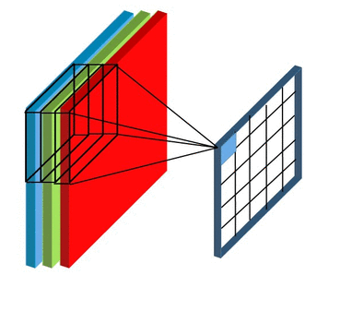
Convolution: Multiple channel input – Single filter

Slide 9
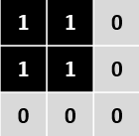
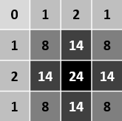
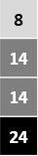
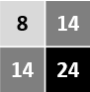
Note: no activation function has been applied in this case – linear demo
Convolution: Multiple channel input – Single filter
Input channel: 1/2
Filter
Filter channel: 1/2
Flattened feature vector
Feature layer
Max pooled
Classify
Input channel: 2/2
X
Filter channel: 2/2
Output
# Feature layers = n_{f} = 1
Size: [F_{x} , F_{y}] = [4, 4]
# Channels / feature = 1
Filter kernel # Filters = n_{f} = 1
Size: [f_{x} , f_{y}] = [3, 3]
Filter depth = n_{c} = 2
Filter bias = b = 0
# Filter weights:
= f_{x} x f_{y} x n_{c} + 1 = 3x3x2 + 1 = 19
Stride: [s_{x} , s_{y}] = [1, 1]
Input Size: [L_{x} , L_{y}] = [4, 4]
# Channels: [n_{c}] = 2
Zero padded
Detects a square
nb: no activation function has been applied after max pooling

Slide 10

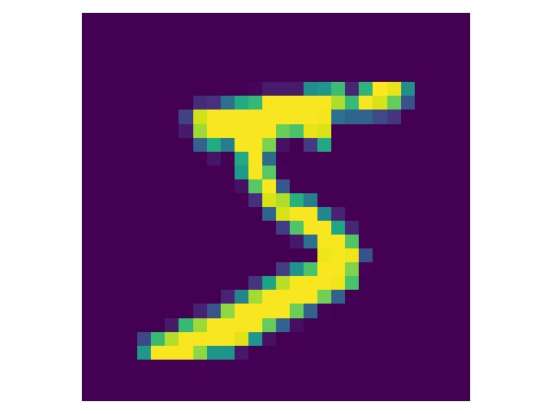
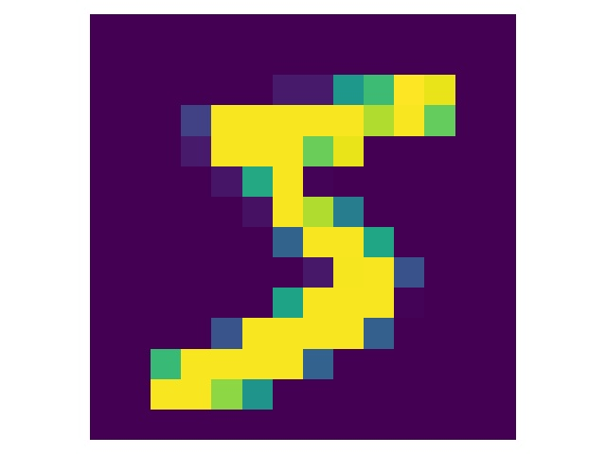
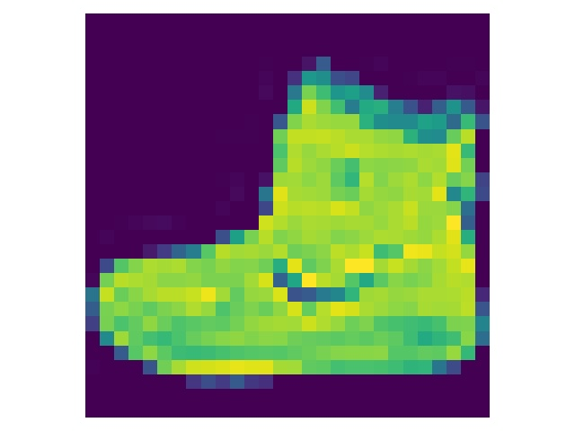
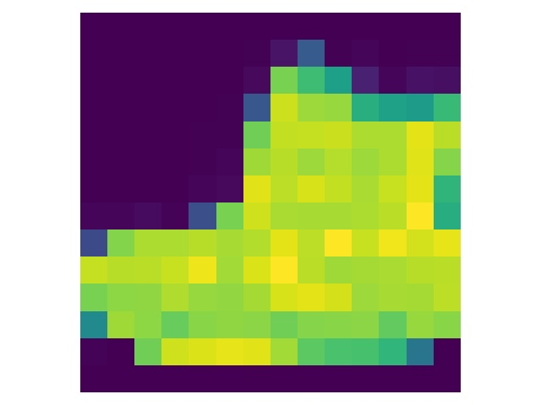
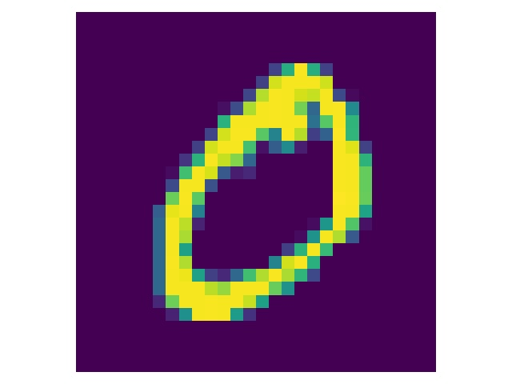
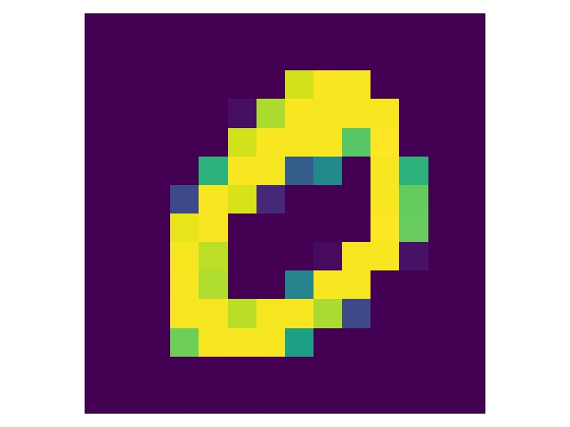
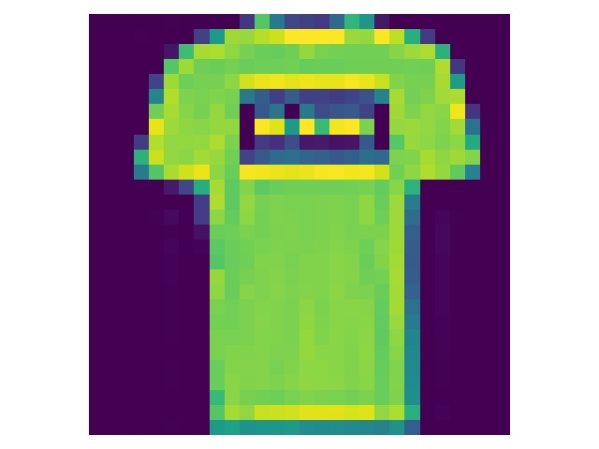
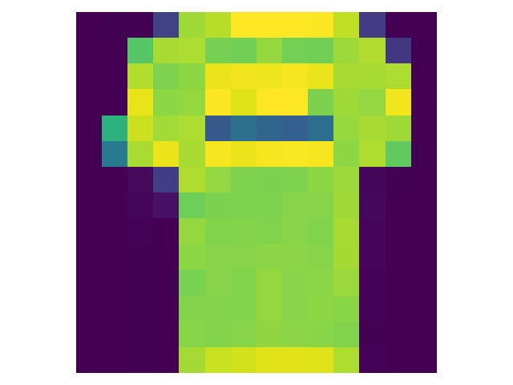
Down sampling through Max(imum) pooling
Input
28x28 pixels
After max-pooling
14x14 pixels
Input
28x28 pixels
After max-pooling
14x14 pixels

Slide 11
Two-layer convolutional network (digits MNIST)
60000 Training samples
10000 Test samples
Optimizer: gradient descent, MSE
Rectified linear activation function in the middle layer
Softmax activation function in the final layer
Receptive field : 20x20
Batch size : 1000
Epochs: 40
Learning rate:0.05
Convolutional 1st layer
Training accuracy: 98.4%
Test accuracy: 98.3% 125K weights
Fully connected 1st layer (20 HU)
Training accuracy: 97%
Test accuracy: 95.7% 16K weights
Fully connected network parameters: 100 epoch, 1 learning rate, sigmoid activation in the middle layer, 1000 batch size
The receptive fields of the convolutional layer are trained simultaneously for all positions

Slide 12
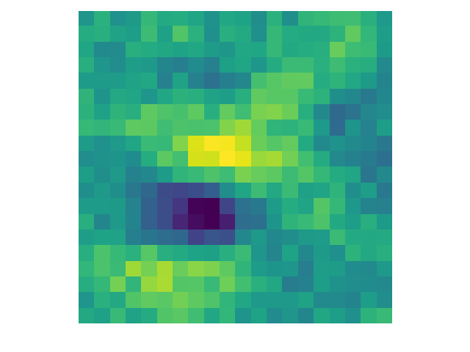
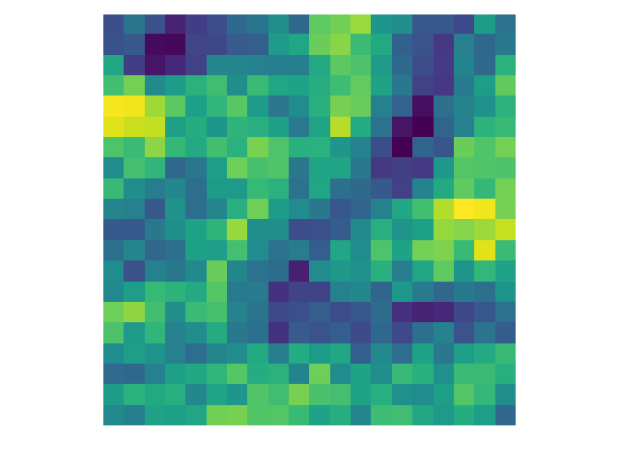
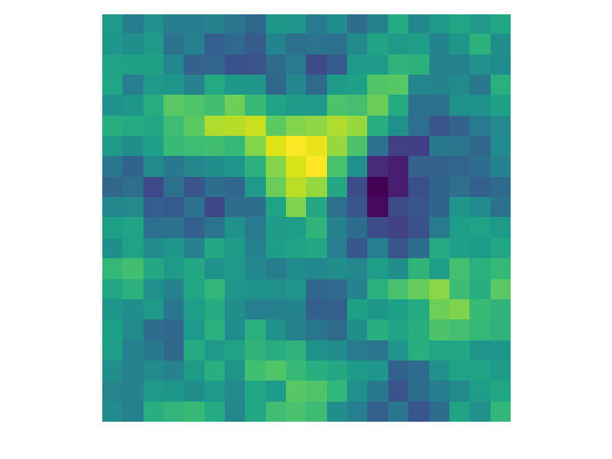
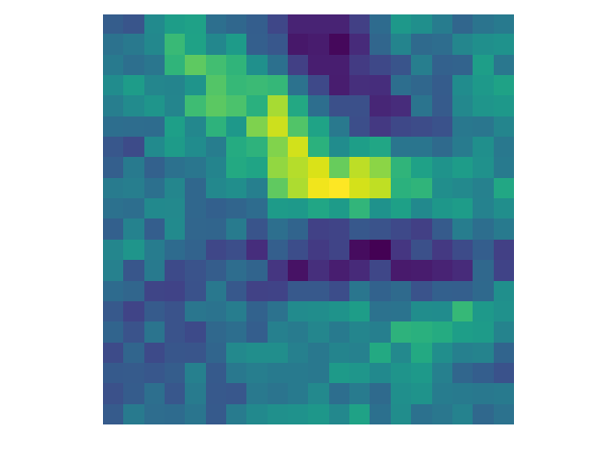
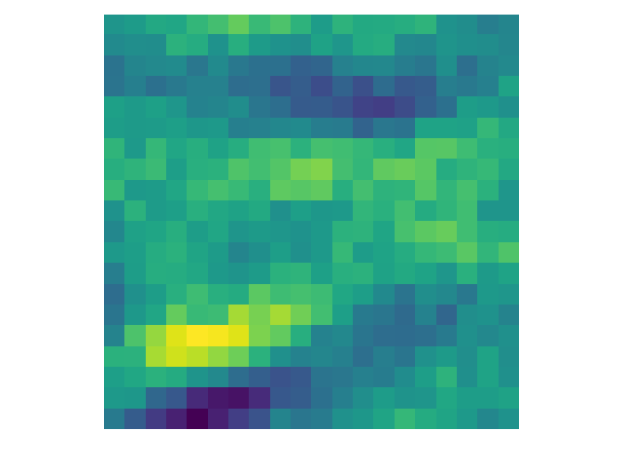
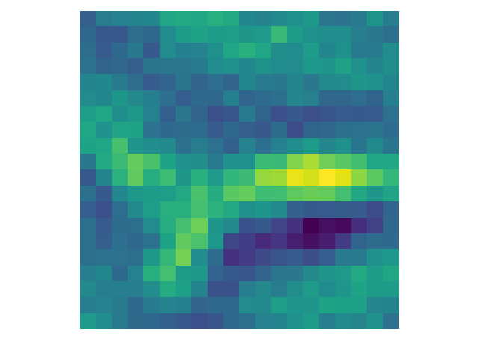
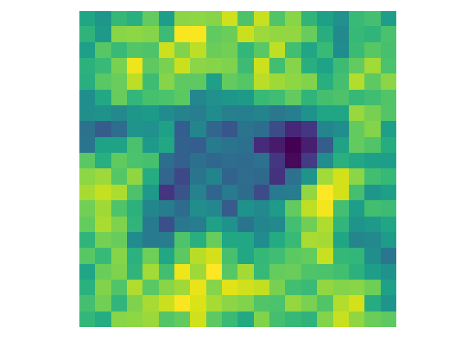
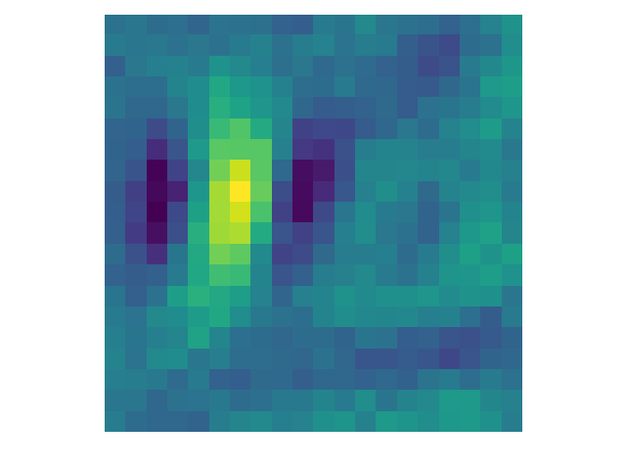
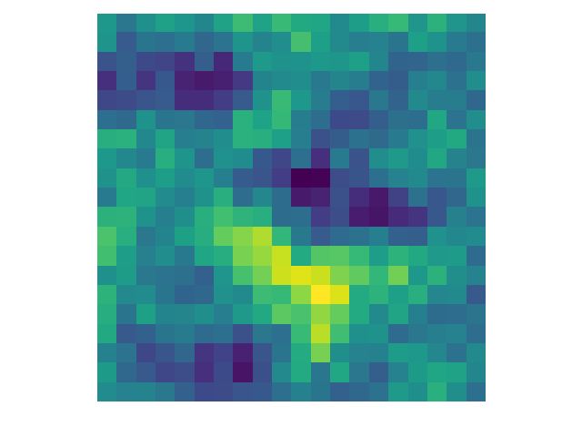
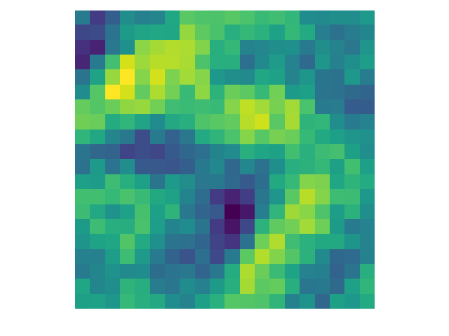
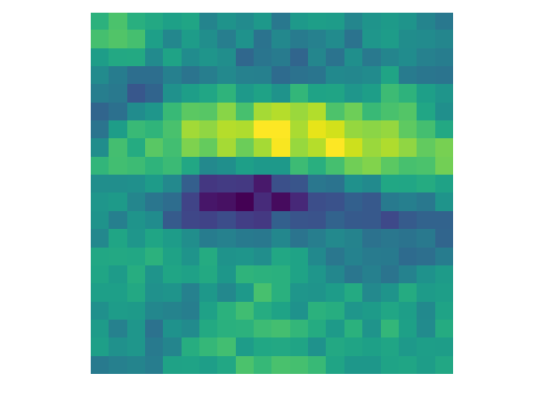
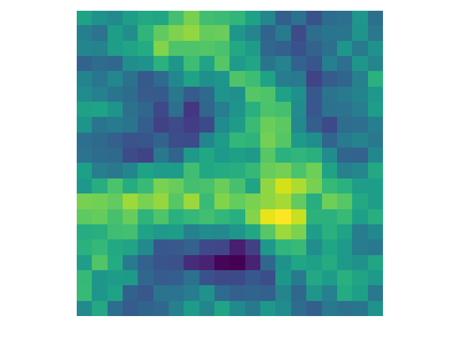
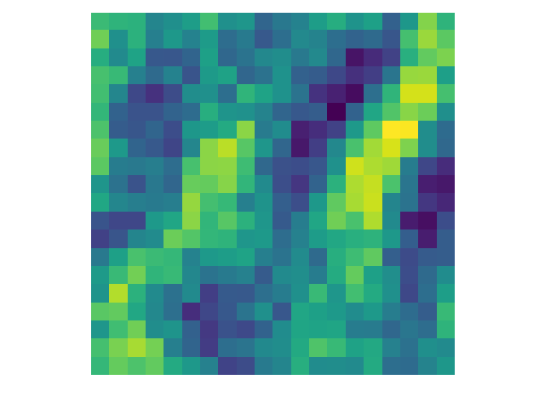
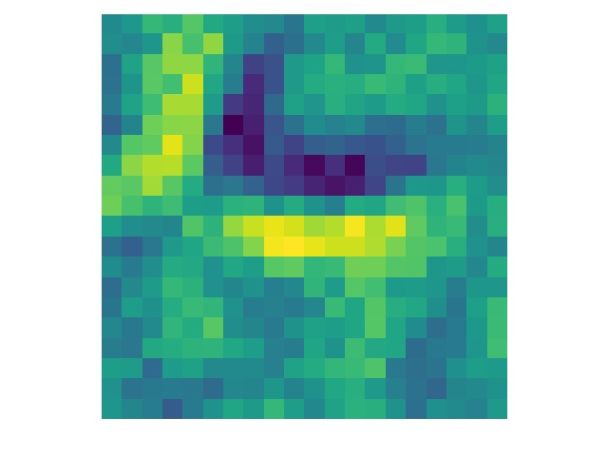
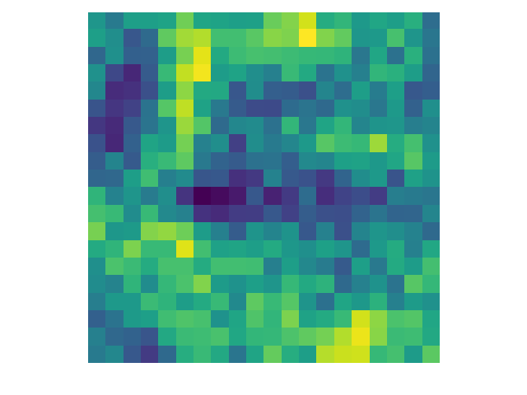
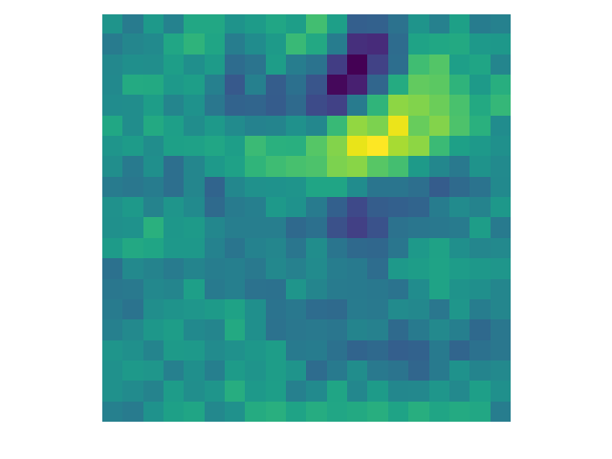
2-layer convolutional network
16 Receptive fields

Slide 13

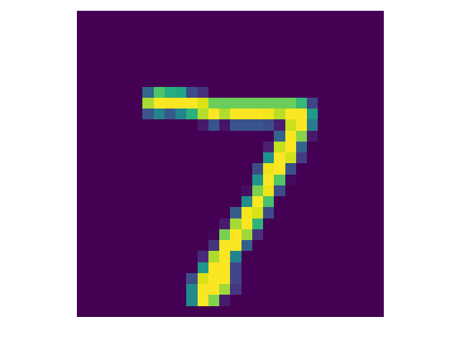
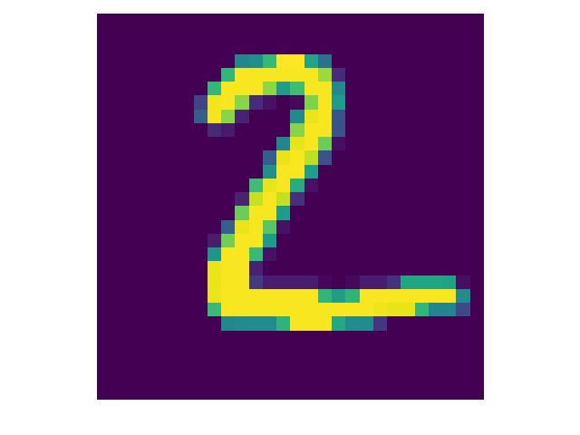
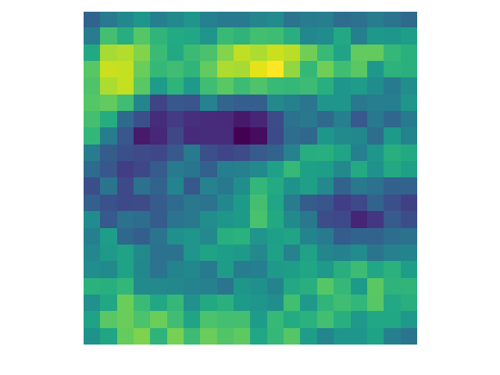
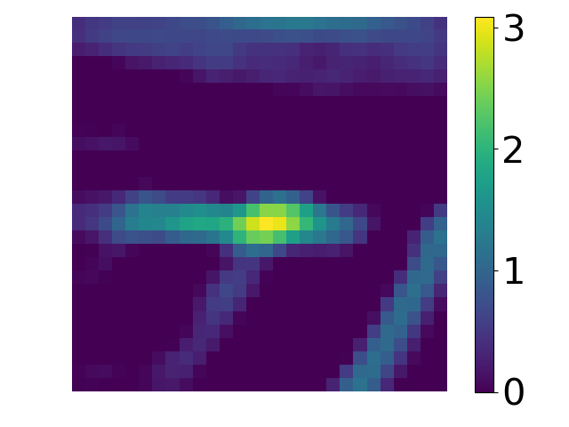
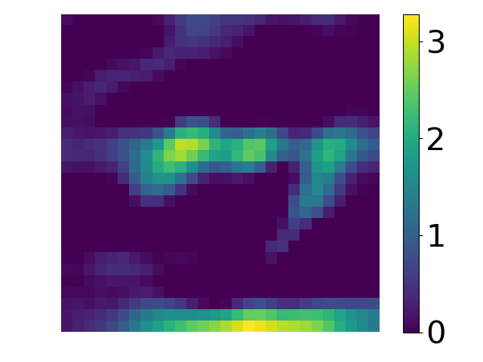
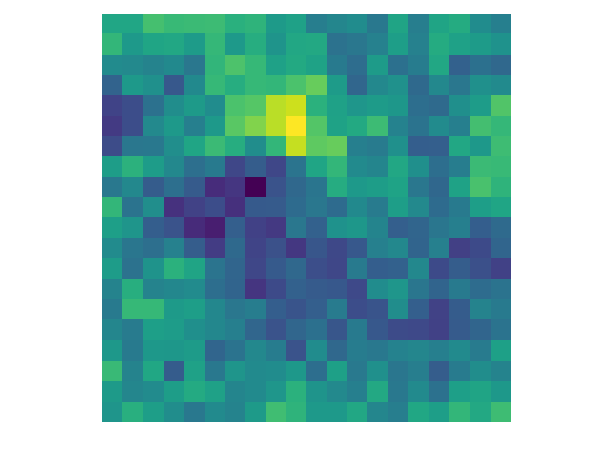
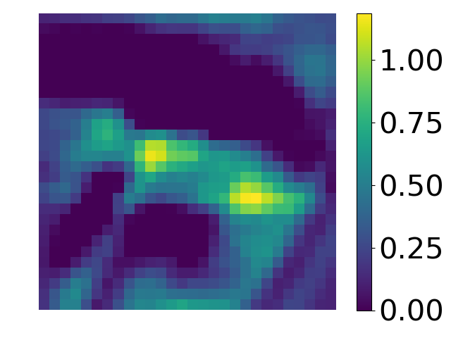
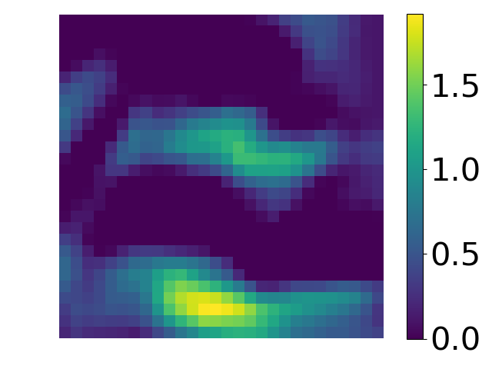
Two-layer convolutional network
Output of the convolutional layer: 16 receptive fields
Input image
Input image
20x20
Receptive field
2 out of 16
Convolutional layer output
Convolutional layer output

Slide 14

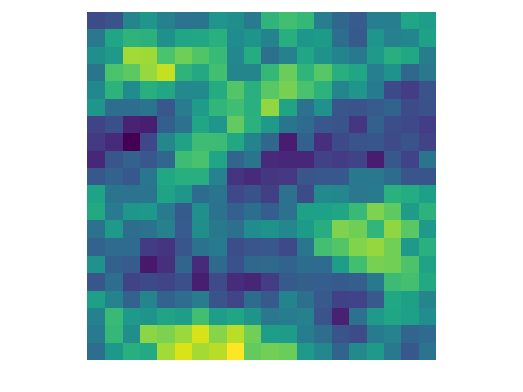
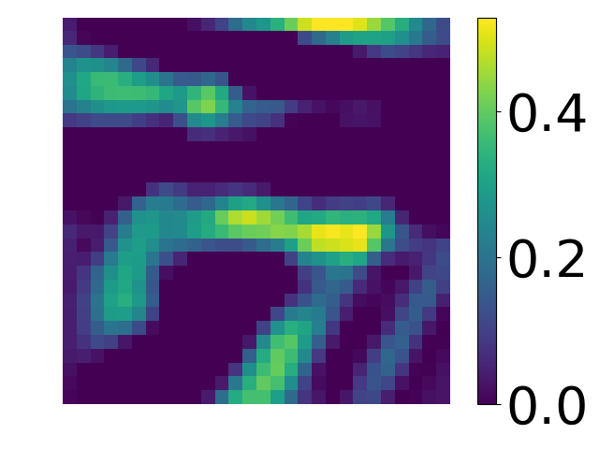
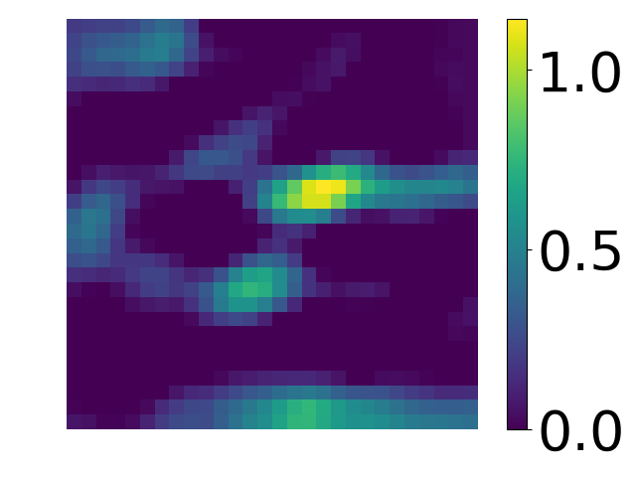



Two-layer convolutional network
Output of the convolutional layer: 100 receptive fields
Input image
Input image
20x20
Receptive field
Convolutional layer output
Convolutional layer output

Slide 15






Fully connected and Convolutional network
Shifted digits
Convolutional neural network
Optimizer: gradient descent, MSE
Rectified linear activation function in the middle layer
Softmax activation function in the final layer
Receptive field : 20x20 with 16 receptive fields
Batch size : 1000
Epochs: 40
Learning rate:0.05
Examples
Original
Shifted
Fully connected network
Optimizer: gradient descent, MSE
Sigmoid activation function in the middle layer
Softmax activation function in the final layer
Hidden units: 20
Batch size : 1000
Epochs: 100
Learning rate: 1

Slide 16
Fully connected and Convolutional network
Shifted digits
Shifted images are not included in the training
Shifted images are included in the training
Test accuracy (%)
Unshifted images
Test accuracy (%)
Shifted images
Test accuracy (%)
Unshifted images
Test accuracy (%)
Shifted images
Convolutional neural network
2 receptive fields
97.2
42.9
97.2
90.6
16 receptive fields
98.3
53.4
98.5
96
100 receptive fields
98.4
54
98.7
96.7
Fully connected network
20 hidden units
95.7
35.8
93.7
80.8

Slide 17


Two-layer convolutional network – Additive noise
Variance of random distribution
0
0.01
0.05
In this example, noisy images are not included in the training.
Convolutional neural network
Accuracy on the test set (%)
2 receptive fields
20x20 pixels each
97.2
44.3
16.00
16 receptive fields
98.3
47.47
25.63
100 receptive fields
98.4
68.21
34.65
Fully connected network
20 hidden units
95.7
27
16.9

Slide 18


Two-layer convolutional network - Receptive fields

Slide 19

MNIST Fashion
10 different classes
60000 training samples
10000 test samples

Slide 20



MNIST Fashion: 2-layer network
60000 Training samples
10000 Test samples
Optimizer: gradient descent
Rectified linear activation function in the middle layer
Softmax activation function in the final layer
Receptive field : 3x3
Batch size : 1000
Overfitting

Slide 21


MNIST Fashion: 2-layer network + Dropout
Dropout layer is applied to the convolutional layer
Dropout prevents the overfitting and increases the test accuracy

Slide 22

Vgg (Oxford Visual Geometry Group)
The receptive fields of the convolutional layers are trained simultaneously for all positions

Slide 23



MNIST Fashion: Deep neural networks
(Vgg: Visual geometry group, Oxford)
60000 Training samples
10000 Test samples
Optimizer: gradient descent
Rectified linear activation function in the middle layer
Softmax activation function in the final layer
Receptive field : 3x3
Batch size : 1000

Slide 24


MNIST Fashion: Deep neural networks + Dropout
Drop-out is applied to ALL the hidden units
Network Type | Dropout | Training Accuracy | Test Accuracy
2 layer | No | 100 | 89.7
2 layer | Yes | 96.7 | 90.1
Vgg | No | 99.3 | 90.7
Vgg | Yes | 98.1 | 92.2

Slide 25

H2O droplets in oil
Water can dissolve alcohol. When water dissolves the alcohol, the surface tension and the density of the mixture changes.
https://www.youtube.com/watch?v=SX-fh5MFqpk

Slide 26


Surface tension
Surface tension of alcohol (IPA) and water mixing solutions as a function of IPA concentration.
Surface tension
0.072 N/m
Surface tension
0.028 N/m
Surface tension determines the droplet size after the detachment.
Adding alcohol to water changes the surface tension.
Diagram: Park, Jin-Goo, et al. "Interfacial and electrokinetic characterization of IPA solutions related to semiconductor wafer drying and cleaning." Journal of the Electrochemical society 153.9 (2006): G811-G814.

Slide 27


Droplet detachment
Droplet size is determined by:
Velocity of liquids
Surface tension
Viscosity of liquids
Force balance image: Wu, Ping, et al. "Drag-induced breakup mechanism for droplet generation in dripping within flow focusing microfluidics." Chinese Journal of Chemical Engineering 23.1 (2015): 7-14.

Slide 28




Learning: Droplets
Sample preparation

Slide 29


Effect of isopropanol concentration
Oil
Water
Solution
5% Isopropanol in water solution
Oil
20% Isopropanol in water solution
Droplet generation in different concentration of IPA in water
The surface tension between the oil and the water solution changes by concentration
The droplet diameter and the distance between droplets depend on the surface tension

Slide 30


Effect of isopropanol concentration
4% Isopropanol in water solution
4.5% Isopropanol in water solution
5% Isopropanol in water solution
Seven concentrations: 4% to 7% with 0.5% resolution
3600 Samples in the Training Data set for each concentration
400 Samples for each class to test

Slide 31





Nearest neighbor clustering method
Nearest Neighbour
4%
4.5%
5%
5.5%
6%
6.5%
54.04% correct classification
7%

Slide 32



Convolutional Neural Network
Droplet images classification
Input image
Raw image
Four different concentrations: 5% to 20% with 5% resolution
3600 Samples in the Training Data set for each concentration
400 Samples for each class to test

Slide 33


Droplet images classification
Examples of correct classification
Examples of classification
4%
4.5%
5%
5.5%
6%
6.5%
It gives 97% accuracy over 2800 samples
7%

Slide 34



Flow rate measurement

